Slide 1
Socio-technical Systems

Slide 2
Objectives
To explain what a socio-technical system is and the distinction between this and a computer-based system
To introduce the concept of emergent system properties such as reliability and security
To explain system engineering and system procurement processes
To explain why the organisational context of a system affects its design and use
To discuss legacy systems and why these are critical to many businesses

Slide 3
Topics covered
Emergent system properties
Systems engineering
Organizations, people and computer systems
Legacy systems

Slide 4
What is a system?
A purposeful collection of inter-related components working together to achieve some common objective.
A system may include software, mechanical, electrical and electronic hardware and be operated by people.
System components are dependent on other
system components
The properties and behaviour of system components are inextricably inter-mingled

Slide 5
System categories
Technical computer-based systems
  Systems that include hardware and software but where the operators and operational processes are not normally considered to be part of the system. The system is not self-aware.
Socio-technical systems
  Systems that include technical systems but also operational processes and people who use and interact with the technical system. Socio-technical systems are governed by organisational policies and rules.

Slide 6
Socio-technical system characteristics
Emergent properties
  Properties of the system of a whole that depend on the system components and their relationships.
Non-deterministic
  They do not always produce the same output when presented with the same input because the systems’s behaviour is partially dependent on human operators.
Complex relationships with organisational objectives
  The extent to which the system supports organisational objectives does not just depend on the system itself.

Slide 7
Emergent properties
Properties of the system as a whole rather than properties that can be derived from the properties of components of a system
Emergent properties are a consequence of the relationships between system components
They can therefore only be assessed and measured once the components have been integrated into a system

Slide 8
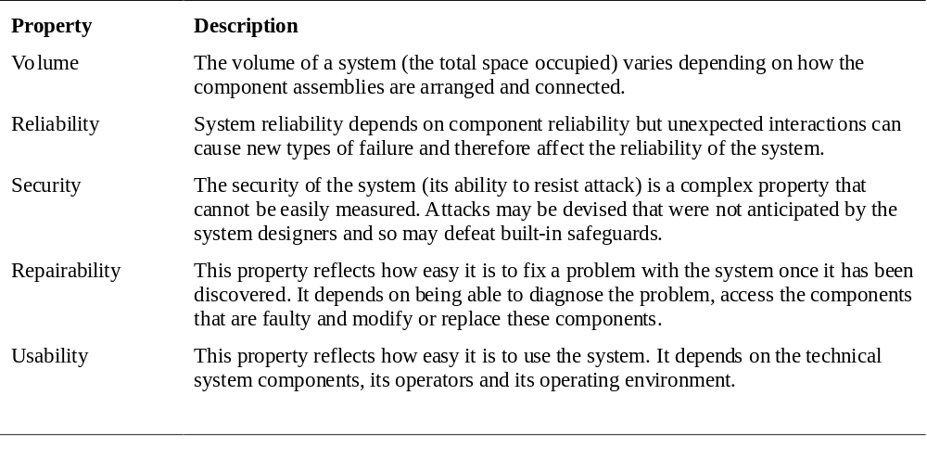
Examples of emergent properties

Slide 9
Types of emergent property
Functional properties
  These appear when all the parts of a system work together to achieve some objective. For example, a bicycle has the functional property of being a transportation device once it has been assembled from its components.
Non-functional emergent properties
  Examples are reliability, performance, safety, and security. These relate to the behaviour of the system in its operational environment. They are often critical for computer-based systems as failure to achieve some minimal defined level in these properties may make the system unusable.

Slide 10
System reliability engineering
Because of component inter-dependencies,
faults can be propagated through the system.
System failures often occur because of
unforeseen inter-relationships between
components.
It is probably impossible to anticipate all
possible component relationships.
Software reliability measures may give a false
picture of the system reliability.

Slide 11
Influences on reliability
Hardware reliability
  What is the probability of a hardware component failing and how long does it take to repair that component?
Software reliability
  How likely is it that a software component will produce an incorrect output. Software failure is usually distinct from hardware failure in that software does not wear out.
Operator reliability
  How likely is it that the operator of a system will make an error?

Slide 12
Reliability relationships
Hardware failure can generate spurious signals that are outside the range of inputs expected by the software.
Software errors can cause alarms to be activated which cause operator stress and lead to operator errors.
The environment in which a system is installed can affect its reliability.

Slide 13
The ‘shall-not’ properties
Properties such as performance and reliability can be measured.
However, some properties are properties that the system should not exhibit
  Safety - the system should not behave in an unsafe way;
  Security - the system should not permit unauthorised use.
Measuring or assessing these properties is very hard.

Slide 14
Systems engineering
Specifying, designing, implementing, validating, deploying and maintaining socio-technical systems.
Concerned with the services provided by the system, constraints on its construction and operation and the ways in which it is used.

Slide 15
The system engineering process
Usually follows a ‘waterfall’ model because of the need for parallel development of different parts of the system
  Little scope for iteration between phases because hardware changes are very expensive. Software may have to compensate for hardware problems.
Inevitably involves engineers from different disciplines who must work together
  Much scope for misunderstanding here. Different disciplines use a different vocabulary and much negotiation is required. Engineers may have personal agendas to fulfil.

Slide 16
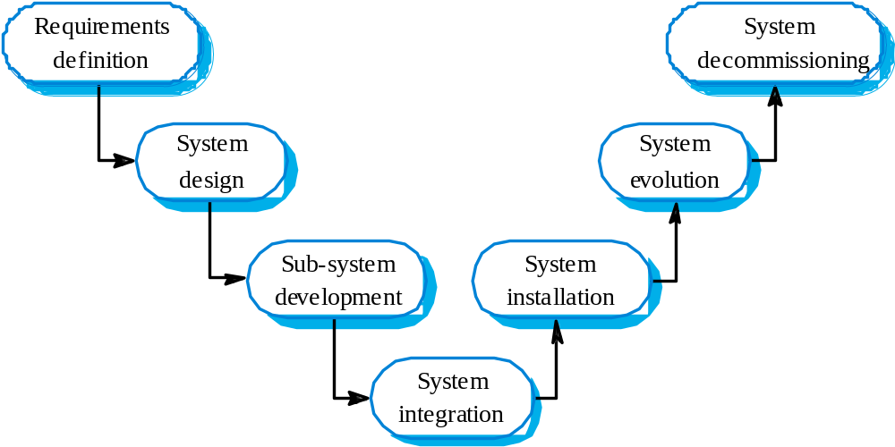
The systems engineering process

Slide 17
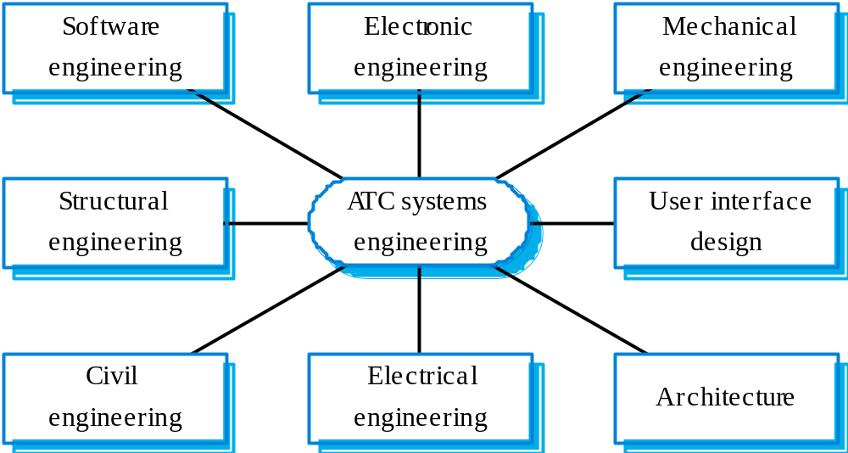
Inter-disciplinary involvement

Slide 18
System requirements definition
Three types of requirement defined at this stage
  Abstract functional requirements. System functions are defined in an abstract way;
  System properties. Non-functional requirements for the system in general are defined;
  Undesirable characteristics. Unacceptable system behaviour is specified.
Should also define overall organisational objectives for the system.

Slide 19
System objectives
Should define why a system is being procured for a particular environment.
Functional objectives
  To provide a fire and intruder alarm system for the building which will provide internal and external warning of fire or unauthorized intrusion.
Organisational objectives
  To ensure that the normal functioning of work carried out in the building is not seriously disrupted by events such as fire and unauthorized intrusion.

Slide 20
System requirements problems
Complex systems are usually developed to address wicked problems
  Problems that are not fully understood;
  Changing as the system is being specified.
Must anticipate hardware/communications
developments over the lifetime of the system.
Hard to define non-functional requirements
(particularly) without knowing the
component structure of the system.

Slide 21
The system design process
Partition requirements
  Organise requirements into related groups.
Identify sub-systems
  Identify a set of sub-systems which collectively can meet the system requirements.
Assign requirements to sub-systems
  Causes particular problems when COTS are integrated.
Specify sub-system functionality.
Define sub-system interfaces
  Critical activity for parallel sub-system development.

Slide 22
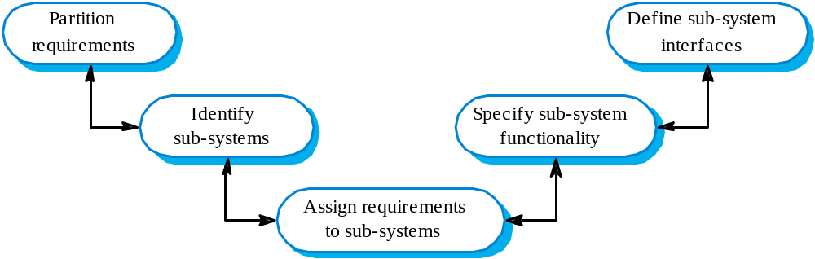
The system design process

Slide 23
System design problems
Requirements partitioning to hardware,
software and human components may involve a lot of negotiation.
Difficult design problems are often assumed to be readily solved using software.
Hardware platforms may be inappropriate for
software requirements so software must compensate for this.

Slide 24
Requirements and design
Requirements engineering and system design are inextricably linked.
Constraints posed by the system’s environment and other systems limit design choices so the actual design to be used may be a requirement.
Initial design may be necessary to structure the requirements.
As you do design, you learn more about the requirements.

Slide 25
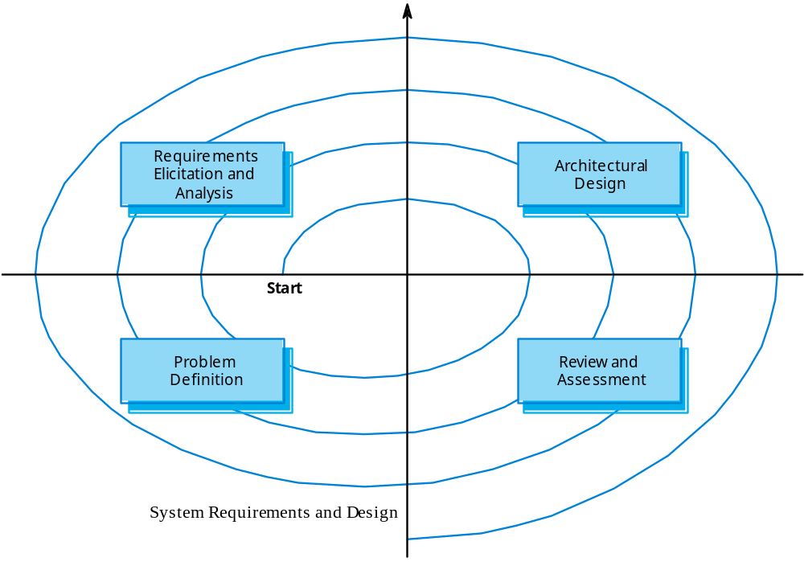
Spiral model of requirements/design

Slide 26
System modelling
An architectural model presents an abstract view of the sub-systems making up a system
May include major information flows between sub-systems
Usually presented as a block diagram
May identify different types of functional component in the model

Slide 27
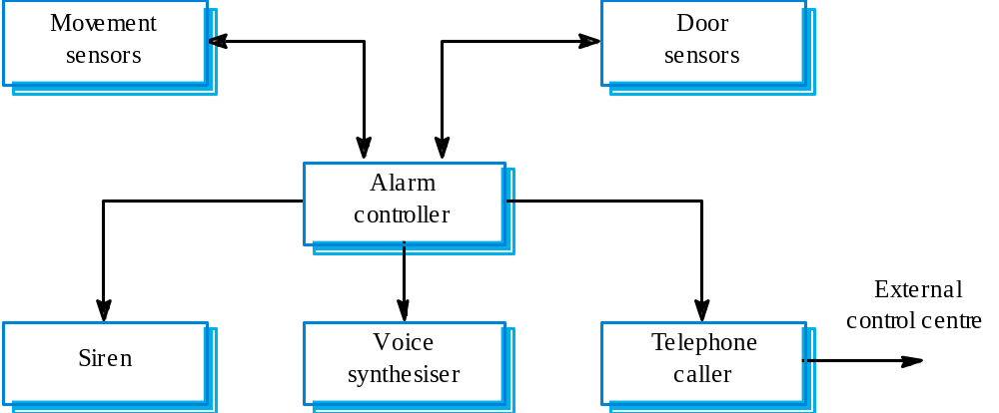
Burglar alarm system

Slide 28
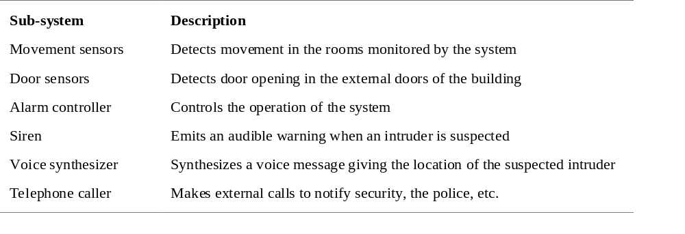
Sub-system description

Slide 29
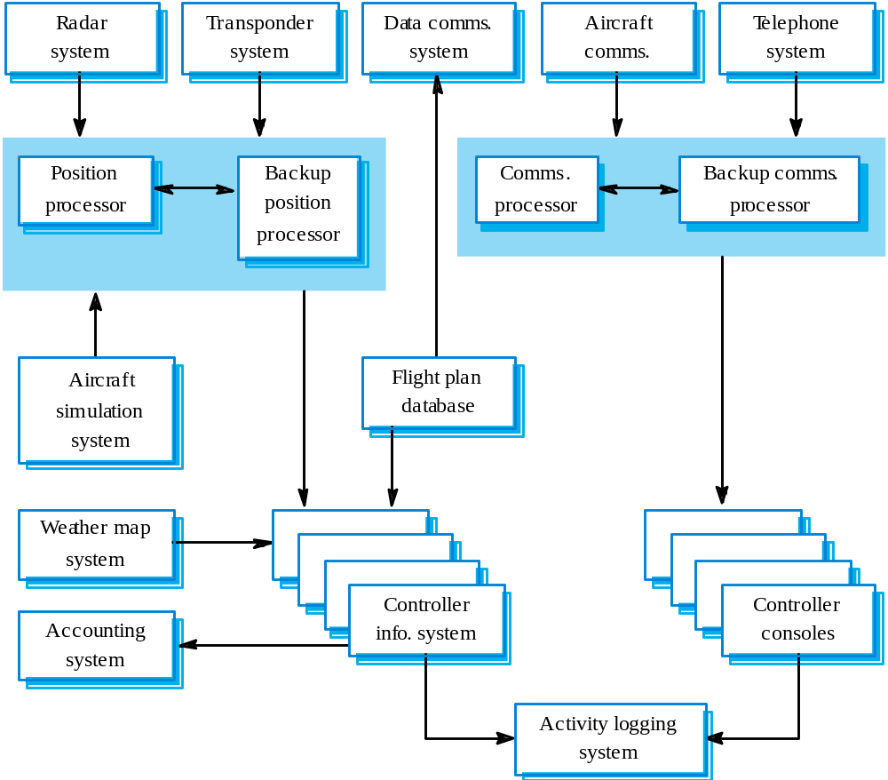
ATC system architecture

Slide 30
Sub-system development
Typically parallel projects developing the
hardware, software and communications.
May involve some COTS (Commercial Off-the-Shelf) systems procurement.
Lack of communication across implementation
teams.
Bureaucratic and slow mechanism for
proposing system changes means that the development schedule may be extended because of the need for rework.

Slide 31
System integration
The process of putting hardware, software and
people together to make a system.
Should be tackled incrementally so that sub-systems are integrated one at a time.
Interface problems between sub-systems are usually found at this stage.
May be problems with uncoordinated deliveries
of system components.

Slide 32
System installation
After completion, the system has to be installed in the customer’s environment
  Environmental assumptions may be incorrect;
  May be human resistance to the introduction of
  a new system;
  System may have to coexist with alternative
  systems for some time;
  May be physical installation problems (e.g.
  cabling problems);
  Operator training has to be identified.

Slide 33
System evolution
Large systems have a long lifetime. They must evolve to meet changing requirements.
Evolution is inherently costly
  Changes must be analysed from a technical and business perspective;
  Sub-systems interact so unanticipated problems can arise;
  There is rarely a rationale for original design decisions;
  System structure is corrupted as changes are made to it.
Existing systems which must be maintained are sometimes called legacy systems.

Slide 34
System decommissioning
Taking the system out of service after its useful lifetime.
May require removal of materials (e.g. dangerous chemicals) which pollute the environment
  Should be planned for in the system design by encapsulation.
May require data to be restructured and converted to be used in some other system.

Slide 35
Organisations/people/systems
Socio-technical systems are organisational systems intended to help deliver some organisational or business goal.
If you do not understand the organisational environment where a system is used, the system is less likely to meet the real needs of the business and its users.

Slide 36
Human and organisational factors
Process changes
  Does the system require changes to the work processes in the environment?
Job changes
  Does the system de-skill the users in an environment or cause them to change the way they work?
Organisational changes
  Does the system change the political power structure in an organisation?

Slide 37
Organisational processes
The processes of systems engineering overlap and interact with organisational procurement processes.
Operational processes are the processes involved in using the system for its intended purpose. For new systems, these have to be defined as part of the system design.
Operational processes should be designed to be flexible and should not force operations to be done in a particular way. It is important that human operators can use their initiative if problems arise.

Slide 38
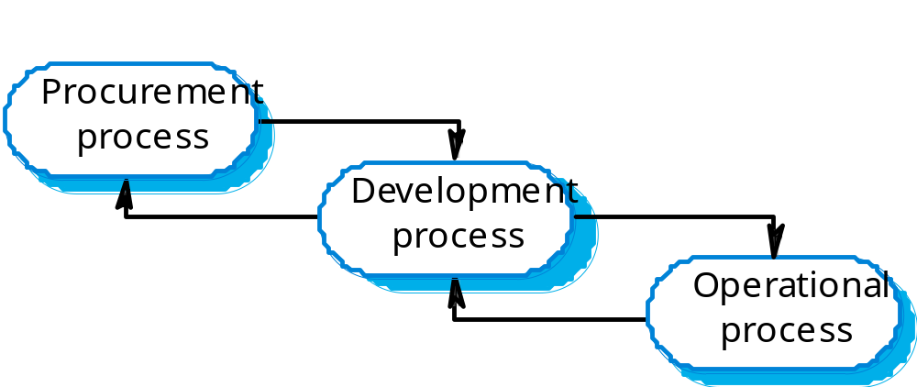
Procurement/development processes

Slide 39
System procurement
Acquiring a system for an organization to meet some need
Some system specification and architectural design is usually necessary before procurement
  You need a specification to let a contract for system development
  The specification may allow you to buy a commercial off-the-shelf (COTS) system. Almost always cheaper than developing a system from scratch
Large complex systems usually consist of a mix of off the shelf and specially designed components. The procurement processes for these different types of component are usually different.

Slide 40
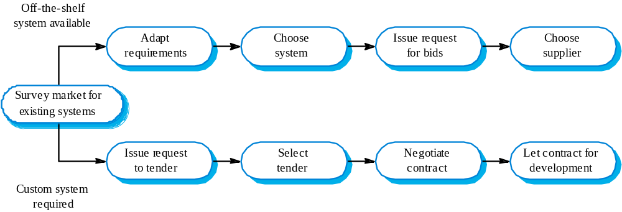
The system procurement process

Slide 41
Procurement issues
Requirements may have to be modified to match the capabilities of off-the-shelf components.
The requirements specification may be part of the contract for the development of the system.
There is usually a contract negotiation period to agree changes after the contractor to build a system has been selected.

Slide 42
Contractors and sub-contractors
The procurement of large hardware/software systems is usually based around some principal contractor.
Sub-contracts are issued to other suppliers to supply parts of the system.
Customer liases with the principal contractor and does not deal directly with sub-contractors.

Slide 43
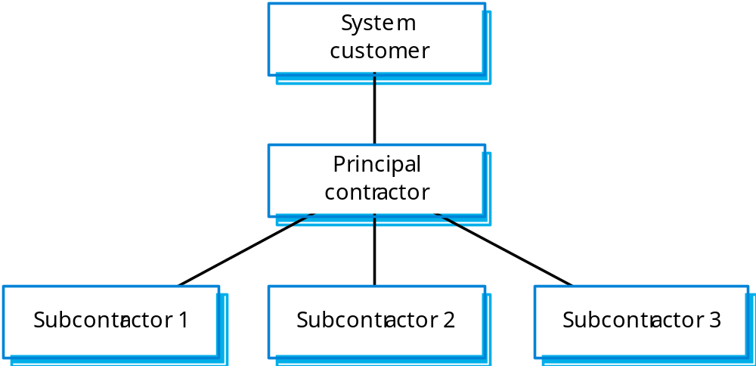
Contractor/Sub-contractor model

Slide 44
Legacy systems
Socio-technical systems that have been developed using old or obsolete technology.
Crucial to the operation of a business and it is often too risky to discard these systems
  Bank customer accounting system;
  Aircraft maintenance system.
Legacy systems constrain new business processes and consume a high proportion of company budgets.

Slide 45
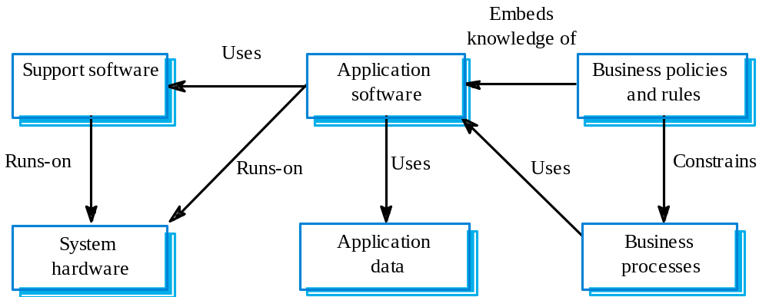

Slide 46
Legacy system components
Hardware - may be obsolete mainframe hardware.
Support software - may rely on support software from suppliers who are no longer in business.
Application software - may be written in obsolete programming languages.
Application data - often incomplete and inconsistent.
Business processes - may be constrained by software structure and functionality.
Business policies and rules - may be implicit and embedded in the system software.

Slide 47
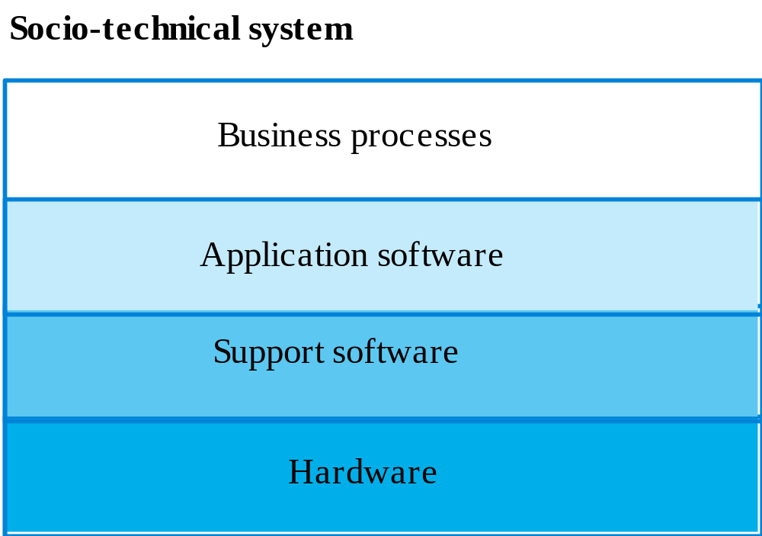

Slide 48
Key points
Socio-technical systems include computer hardware, software and people and are designed to meet some business goal.
Emergent properties are properties that are characteristic of the system as a whole and not its component parts.
The systems engineering process includes specification, design, development, integration and testing. System integration is particularly critical.

Slide 49
Key points
Human and organisational factors have a significant effect on the operation of socio-technical systems.
There are complex interactions between the processes of system procurement, development and operation.
A legacy system is an old system that continues to provide essential services.
Legacy systems include business processes, application software, support software and system hardware.

